Slide 1
GEOLOGICAL INVESTIGATIONS FOR SUNKOSI STORAGE- CUM-DIVERSION SCHEME, NEPAL
Presented
By
BHUPENDRA SINGH, DIRECTOR,
GEOLOGICAL SURVEY OF INDIA
S.U.: MADHYA PRADESH, BHOPAL
K.LAKSHMANAN, SENIOR GEOLOGIST,
GEOLOGICAL SURVEY OF INDIA
(Presently at PHPA, BHUTAN)

Slide 2
Outline
Introduction
Project Layout
Geological set-up of the Project Site
Observations
RECOMENDATIONS

Slide 3
INTRODUCTION
Saptkosi river is formed by joining of seven major tributaries viz. Sunkosi, Tamakosi, Arun, Indravati, Likhu, Dudh Kosi and Tamir
The river system covers almost eastern Nepal and flows down to Kursela in Bihar state of India, where it joins River Ganga
As a part of master plan for development of the Kosi Basin in Nepal, Saptkosi High Dam Multipurpose project and Sunkosi storage-cum-diversion schemes are contemplated with an objective to generate hydel power, flood control/flood management, navigation and to facilitate irrigation and agriculture.

Slide 4
The Sunkosi storage-cum-diversion scheme envisages construction of a 100 m high dam across river Sunkosi located about 1.5 km d/s of its confluence with Dudhkosi River
A 22.5 km long diversion tunnel (D.T.) at right bank with its intake in u/s of dam
A surface power house with installed capacity of 62 MW is proposed to be located at Khadikop near Katari in district Udaypur

Slide 5
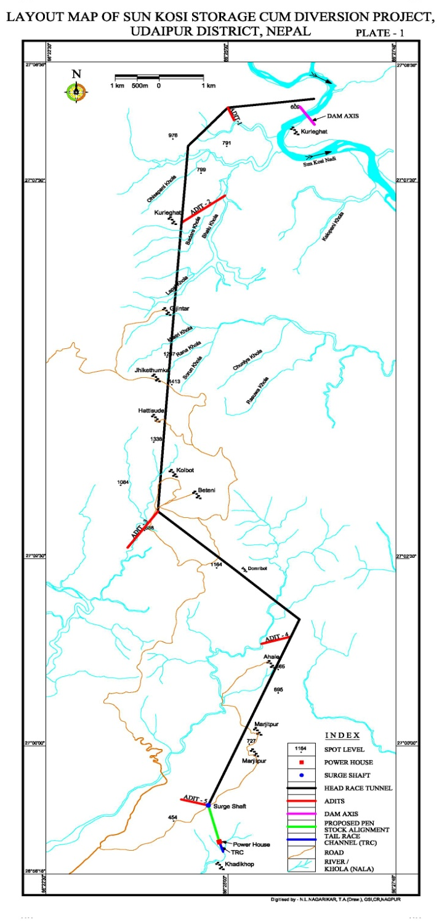
PROJECT LAYOUT
This presentation deals with D.P.R. stage investigations carried out for first 11 km stretch of diversion tunnel.
This D.T. with 6 m diameter is proposed to be excavated through five adits.
The D.T. mostly passes through moderate to thick forest cover
The first eleven km stretch of D.T. have a maximum cover of about 1050 m at R.D. 9.50 km, a minimum cover of 125 m and 160 m will be negotiated at R.D. 550 m and 2.00 km, respectively

Slide 6
GEOLOGICAL SET-UP OF THE PROJECT SITE
Geologically, most part of 11 km reach of D.T. will pass through Meta- sedimentary rocks belonging to Sarung Khola Formation comprising of dark grey to greenish white quartz-biotite schist, quartz felspar biotite-schist, occasionally garnetiferous Interbedded with quartzites
D.T. will pass through contact of Meta-sedimentary of Sarungkhola Formation and granite gneiss of Himal gneisses around R.D. 9.80 km and continues along granite gneisses
The Himal gneiss comprising of mica gneisses, banded gneisses, kayanite bearing gneisses and migmatites, thin marble bands

Slide 7
OBSERVATIONS
The present study is the result of interpretation of projection of surface data to tunnel grade
An attempt has been made to estimate rockmass parameters through projection to tunnel grade with conservative approaches
Overall the rockmass falls in fair category with RMR more than 50, Class-III
However, two major shear zone (SZ) observed at RD 7 km and near Lapsi Khola, where D.T. crosses very prominent broad wide Nala having moderate to steep gradient, the RMR falls in poor category due to influence of major shear zone

Slide 8
RD(m) | Alignment | Structural details | Estimated Geomechanical parameters (Tentative) | Remarks
00 – 1958 | N 260 º | S1||J1 = 45º-65º/175º - 195º Spc: 1-2 cm; Cont: 2-10 m Smooth planar, tight joint. J2 = 50º - 65º/075 º Spc: 1-2cm; Cont: 1-2 m (Broken); Smooth undulatory, tight joint. J3 = 60 º / 120 º Spc: 5cm; Cont: 2m; undulatory, tight joint | RMR = 55 - 60 Class - III Fair Rock mass | Fair rock mass Rock type - quartz biotite schists - quartz feldspar biotite schists, micaceous quatzites with intrusions of pegmatities, silicate rocks
1958 – 3275 | N220 º | -do- | RMR = 54 - 60 Class - III Fair Rock mass | Fair rock mass Rock type - quartz biotite schists - quartz feldspar biotite schists, micaceous quatzites with intrusions of pegmatities, silicate rocks

Slide 9
3275 – 9800 | N185 º | S1||J1=20º-58º/170º-210º Rolling dip towards upstream of Bhalu Khola. At confluence of Bhalu Khola and Lapsi Khola. There is a drastic change in foliation dip on the downstream direction of Lapsi Khola. That is S1||J1=20º -75º /N -080º J2 =35 º -85 º /040 º -090 º J3 =25 º -85 º /100 º -140 º J4 =60 º -75 º /150 º -250 º J5 = 20 º -85 º /260 º -330 º | RMR = 50 - 55 Class - III Fair Rock mass At confluence of Bhalu Khola and Lapsi Khola RMR = 38 Class - IV Poor Rock mass | Traverse along Bhalu Khola and Lapsi Khola. At RD 7 Km one major L shear is passing degrading the RMR to poor category locally. Another major SZ at HRT crossing below the Lapsi Khola, trending N60⁰E-S60⁰W at location. RMR = 38, Class IV Poor
9800-1100 | N185 º | West of Beteni triple road junction coarse grained granitic rock with crude gneissosity composed of quartz, feldspar, biotite and muscovite. S1 = 56º /010º J1 = 56^{o to} 71º /010º - 025º Spc: 15-30cm; dip Cont: 3 - 5m Rough undulatory, tight joint. J2 = 56º /190º Spc: 5-35 cm; strike Cont: > 2.5m Rough undulatory, tight joint. | RMR = 52 - 58 Class III Fair Rock mass | Lithology / Rock type (Granitic gneisses) from RD 9.8 to RD 11 Km. At Beteni the rock exposed are weathered yellowish green to yellowish brown colored coarse grained with crude gneissosity occasionally garnetiferrous. The fresh rock exposed at Nala sections are hard compact and massive

Slide 10
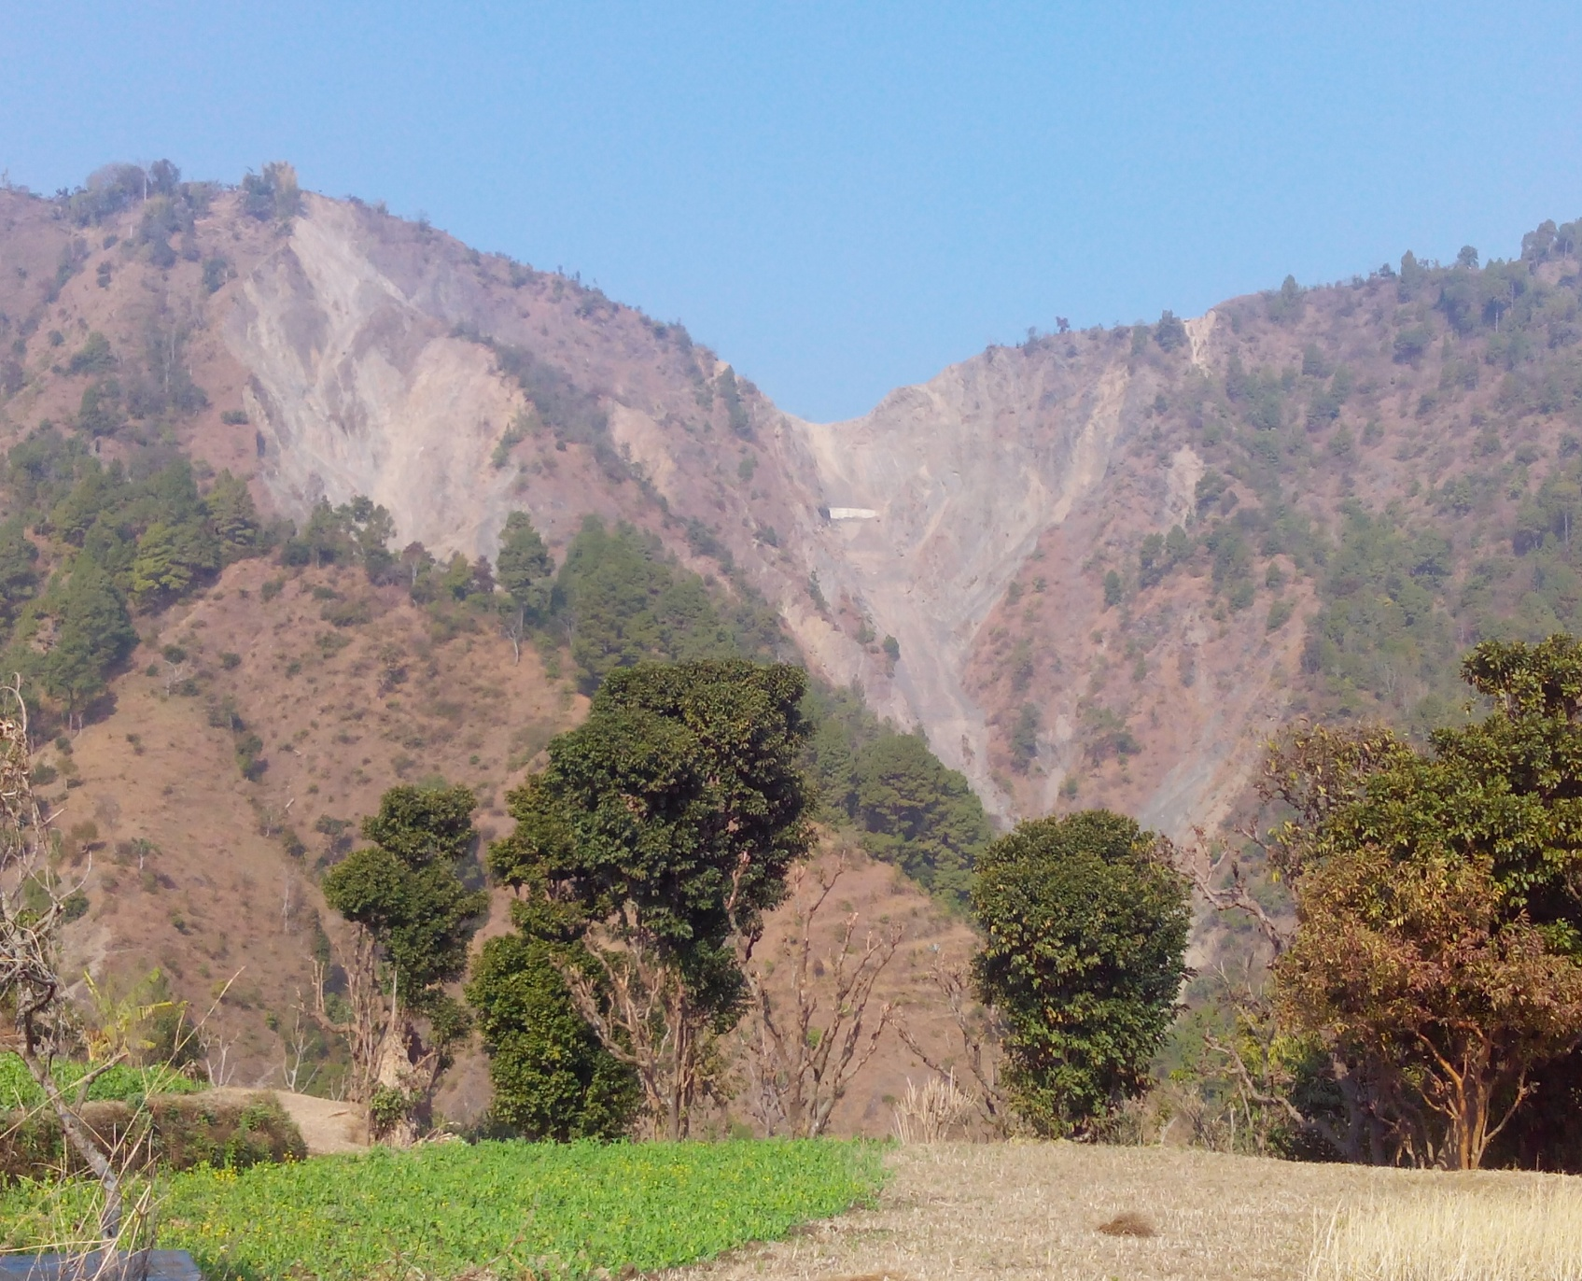
LAPSE KHOLA - MAJOR SHEAR ZONE SUB PARALLEL TO FOLIATION CUTTING ACROSS HRT/DT ALIGNMENT

Slide 11
RECOMENDATIONS
The minimum cover part in D.T. with approximately 125 m and 160 m at R.D. 550 m and R.D. 2.0 km, respectively have been advised to explore through two no. of drill holes to be drilled upto respective invert level of D.T.
Similarly two drill holes has been proposed at R.D. 7 km at Lapsikhola - D.T. crossing to know the extent of shear zone and rockmass conditions above D.T. in SZ influence area

Slide 12
THANK YOU

